Slide 1
Biharmonic Distance Driven Voronoi Diagrams Restricted on Curved Surfaces
Xuetong Zhao, Pengfei Wang, Yining Xu, and Shuangmin Chen，Li Hui
Qingdao University of Science and Technology,Shandong University,Hunan Normal University
Notes:
Good morning everyone. I'm Pengfei Wang from Shandong University. Today I'm honored to present our recent work entitled "Biharmonic Distance Driven Voronoi Diagrams Restricted on Curved Surfaces.”

Slide 2
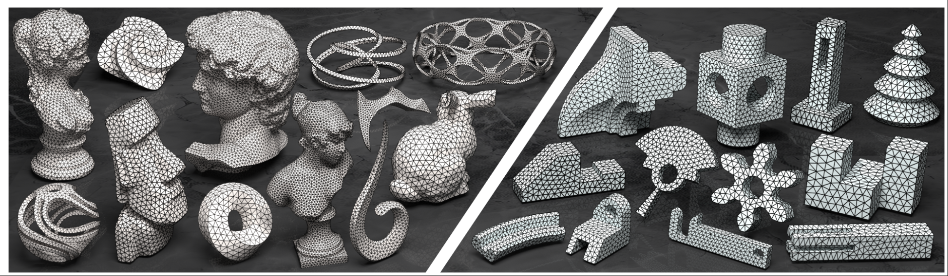
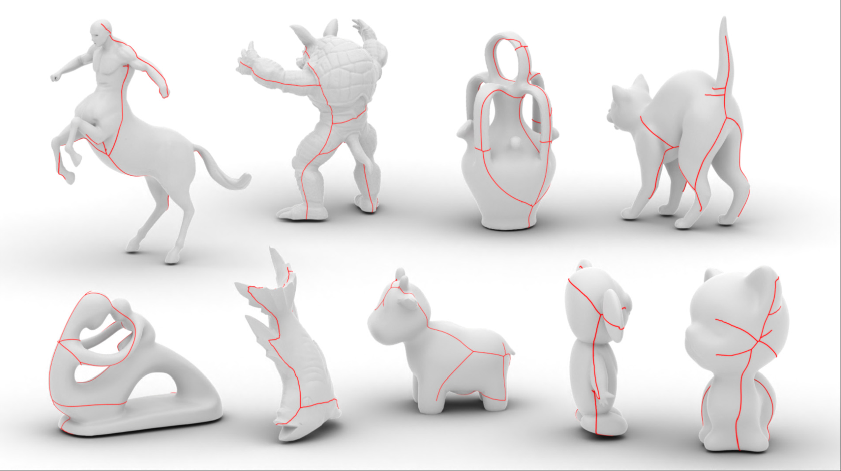
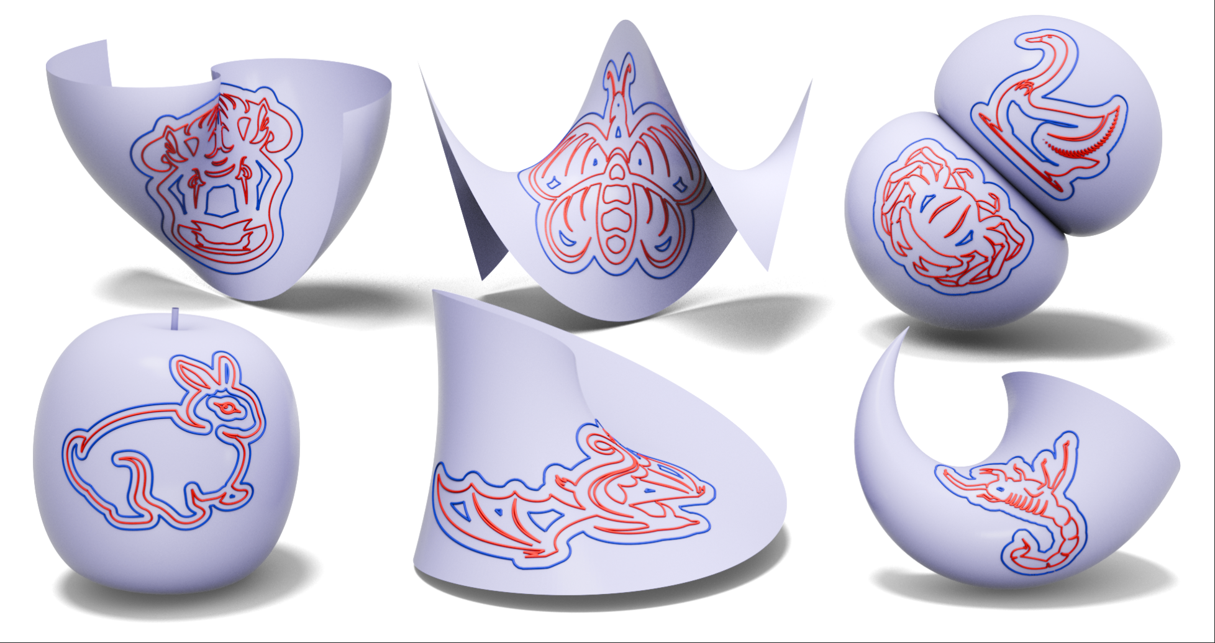
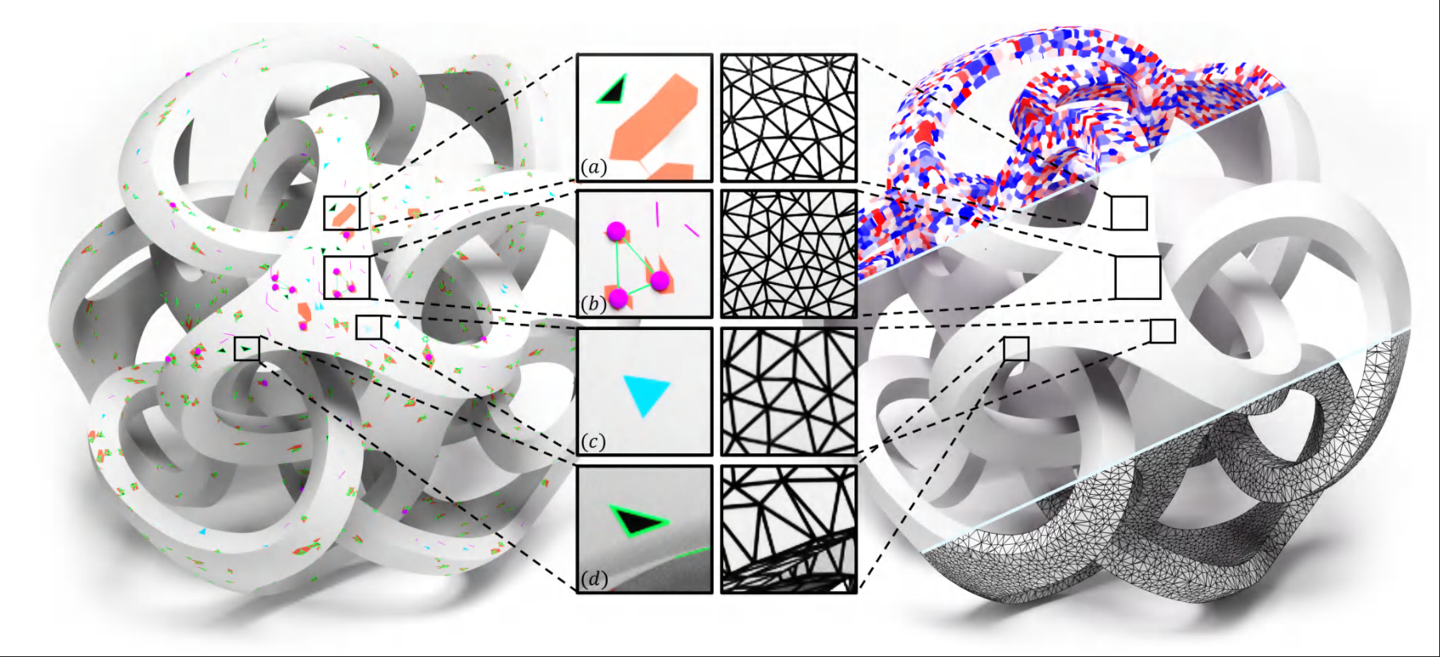
Applications
cut locus computation
remeshing
curve offset on surface
mesh repair
Notes:
Surface Voronoi diagrams have numerous applications in geometry processing. For example, they serve as fundamental tools for model remeshing, cut locus computation, feature-preserving offset curve generation, and mesh repair. These diverse applications demonstrate the importance of having robust and efficient Voronoi diagram algorithms.

Slide 3
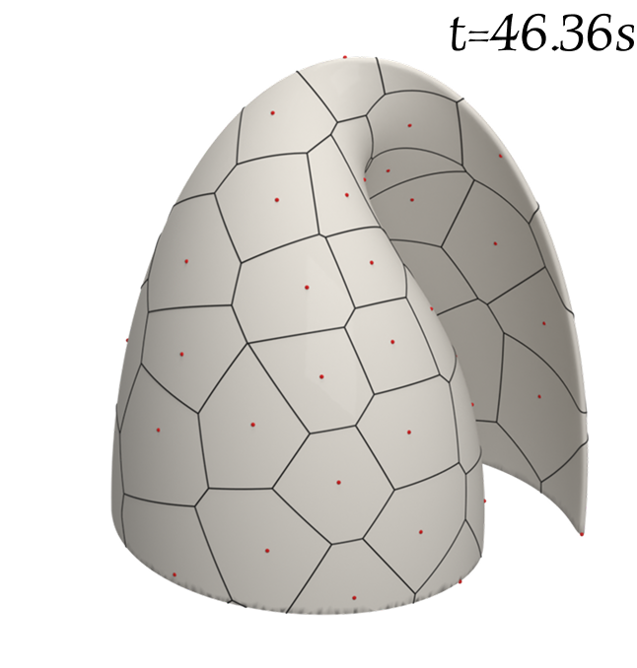
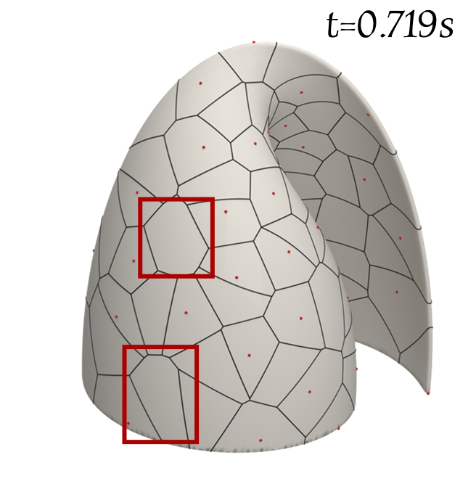
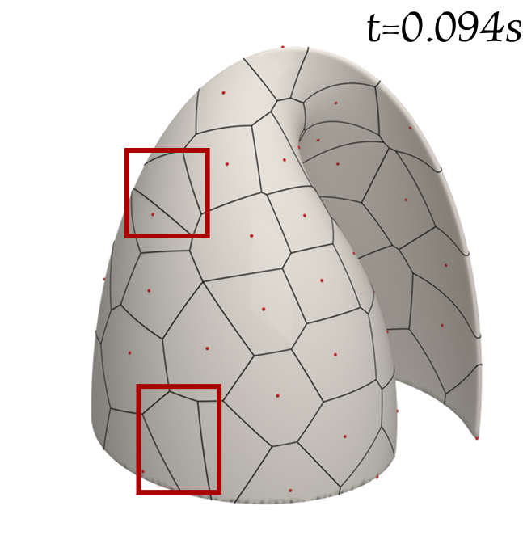
Motivation and Problem Statement
GVD
RVD
LRVD
slow
ownless region
Distorted cells
Notes:
When we construct Voronoi diagrams on curved surfaces, the choice of distance metric is crucial. Let me show you the current challenges:
If we use geodesic distance in GVD, the results are accurate and faithful to the geometry. However, computing geodesic distances is extremely slow, which makes it impractical for big models.
On the other hand, if we use Euclidean distance, we have two strategies. RVD is fast, but it introduces severe artifacts - particularly ownerless regions where Voronoi cells penetrate the surface incorrectly. LRVD, while avoiding ownerless regions, still produces unreasonable cell regions when facing thin-plate problems.
So neither geodesic distance nor Euclidean distance is ideal. This motivates us to look for a distance metric that is both efficient and reliable.

Slide 4
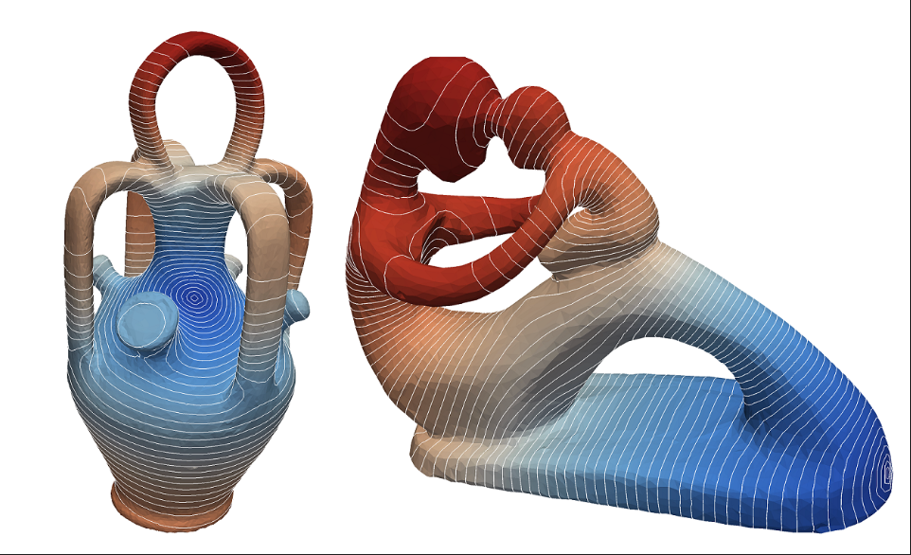
Motivation for Biharmonic Distance
Geodesic: Accurate but slow
Euclidean: Fast but surface penetration
Need: Smooth, intrinsic, efficient computation
Solution: Biharmonic Distance
Notes:
Now let me explain why Biharmonic Distance is a good candidate.
Geodesic distance is accurate, but its computation is slow. Euclidean distance is very fast, but it does not respect the surface geometry and often penetrates through the surface, producing invalid Voronoi cells.
What we really need is a distance that is smooth, intrinsic, and computate efficient. The key idea behind Biharmonic Distance is to use the eigenfunctions of the Laplace-Beltrami operator. These eigenfunctions encode the global structure of the geometry, allowing us to define a distance that combines both local and global information while remaining computationally efficient.

Slide 5
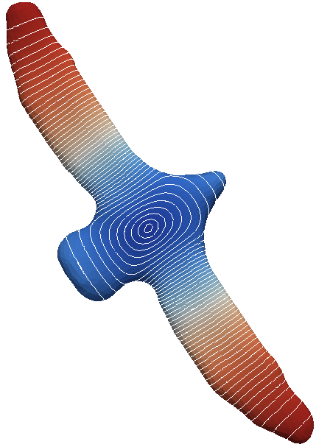
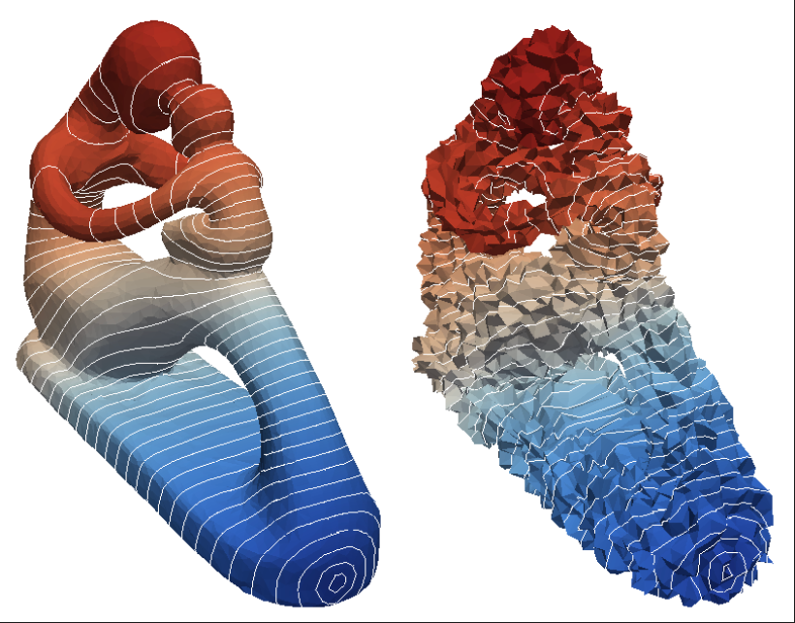
Properties of Biharmonic Distance
Smooth: combines local + global shape information
Robust: less sensitive to noise / mesh irregularities
Practical: can be computed exactly or approximated efficiently
Global shape awareness: preserves structure even on thin shells
Notes:
Biharmonic Distance has several important properties that make it especially suitable for surface processing tasks:
First, it is smooth because it combines both local and global shape information through the spectral representation.
Second, it is robust, meaning it is less sensitive to mesh noise or irregular triangulations.
Third, it is practical, since the computation can be done exactly or approximated efficiently.
Finally, it has global shape awareness. Even on thin-shell structures, the distance still respects the overall geometry and avoids penetration artifacts.
These properties make Biharmonic Distance very powerful for constructing Voronoi diagrams on curved surfaces.

Slide 6
Computation of Biharmonic Distance
Step 1: Eigen decomposition
Compute the first K eigenvalues λ_{k} and eigenfunctions φ_{k} of the Laplace-Beltrami operator
Step 2: High-Dimensional Embedding
Map each vertex x to a K-dimensional vector: (φ1(x)/λ1, φ2(x)/λ2, ..., φK(x)/λK)
Step 3: Distance Computation
Calculate Euclidean distance between two points in K-dimensional space as biharmonic distance approximation
Yaron Lipman, Raif M. Rustamov, and Thomas A. Funkhouser. 2010. Biharmonic distance. ACM Trans. Graph. 29, 3, Article 27 (June 2010), 11 pages. https://doi.org/10.1145/1805964.1805971
Notes:
Now let me explain how we actually compute the Biharmonic distance. The process can be broken down into three main steps:
First, we need to understand the surface's intrinsic structure by performing eigen decomposition. Essentially, we're finding the first K eigenvalues and eigenfunctions of the Laplace-Beltrami operator - think of these as the surface's "fingerprint" that captures its geometric properties.
Next, we transform each vertex into a high-dimensional space. Every vertex gets mapped to a K-dimensional vector where each component is weighted by the inverse of the corresponding eigenvalue. This embedding preserves the surface's geometric relationships.
Finally, computing biharmic distances between any two points becomes surprisingly simple - we just calculate the Euclidean distance between these high-dimensional vectors. This gives us an excellent approximation of the true biharmonic distance.

Slide 7
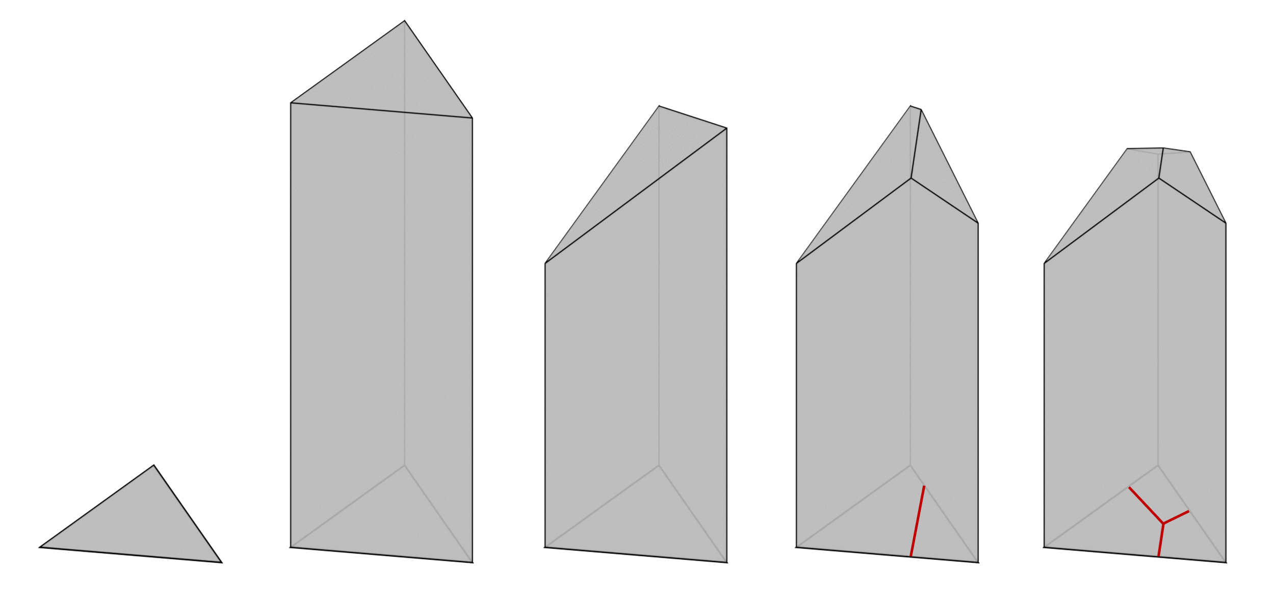
Algorithm Pipeline
Site Embedding
  Sites may lie off-mesh
  Biharmonic Distance supports vertex-to-vertex distances only
  Embed site into mesh vertices via barycentric interpolation
Distance Propagation
  Compute distances from each site in embedding space
  Maintain minimal distances & ownership
Incremental Cutting
  Inside each triangle, linear approximation of distance fields
  Cut along bisectors to form Voronoi boundaries
Notes:
Now let me walk you through our complete algorithm, which works in three stages.
First, we need to handle the fact that Voronoi sites rarely coincide with mesh vertices, while our biharmonic distance is defined between vertices. So we embed these sites into the mesh structure through mesh refinement - essentially adding the sites as new vertices.
Once we have all sites properly embedded, we move to the propagation stage. Here, each site starts spreading its distance field outward from its adjacent triangles. During this propagation process, each triangle stores all the distance fields that contribute to it. We continue this until no more distance events can be propagated.
Finally, we determine the exact boundaries between different Voronoi regions. We do this triangle by triangle, using a 3D lifting technique where we cut along bisectors to extract clean Voronoi boundaries within each triangle.

Slide 8
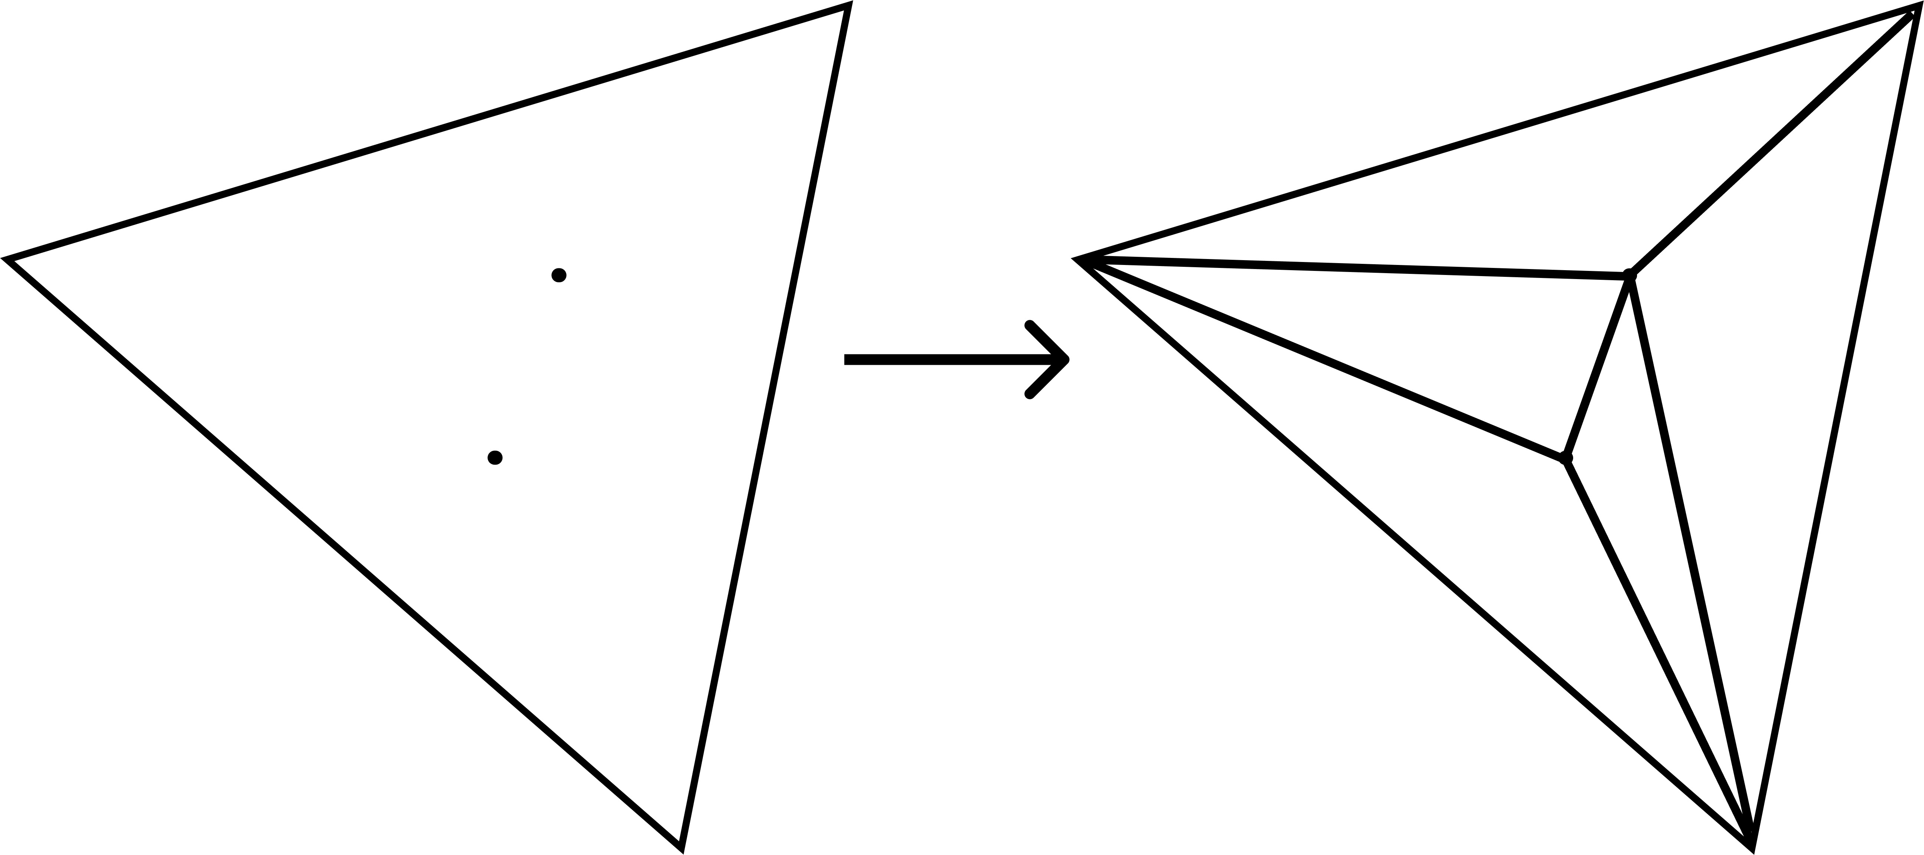
Site Embedding
Sites may not be mesh vertices
Biharmonic Distance → vertex-to-vertex only
Solution: remesh
  Locate face containing site
  Iteratively subdivide triangles containing site
Notes:
Let me explain the first step in detail. Sites may not be mesh vertices, but Biharmonic Distance only works with vertex-to-vertex distances.
There are several ways to handle this mismatch, here we choose the remeshing strategy. The idea is straightforward: we locate the face containing each site, then iteratively subdivide triangles containing sites until all sites become actual mesh vertices.

Slide 9



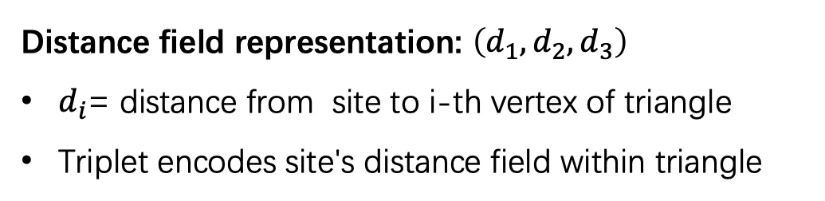

Distance field
$$p_{2}$$
Distance field representation: $\left(d_{1}, d_{2}, d_{3}\right)$
$d_{i}$= distance from site to i-th vertex of triangle
Triplet encodes site's distance field within triangle
$$p_{1}$$
$$when p_{i} cannat be defeated by any site within a triangle,$$
$$it is a contributing point to this triangle$$
Notes:
We adopt the distance field representation from SurfaceVoronoi. For any site, its distance field within a triangle can be represented as a triplet (d₁, d₂, d₃), where dᵢ is the distance from the site to the i-th vertex of the triangle.
To improve computational efficiency, we also introduce a distance field comparison strategy. When comparing distance fields, one is defeated if all three distances are greater than another field. When a site cannot be defeated by any other site within a triangle, it becomes a contributing point to that triangle.

Slide 10
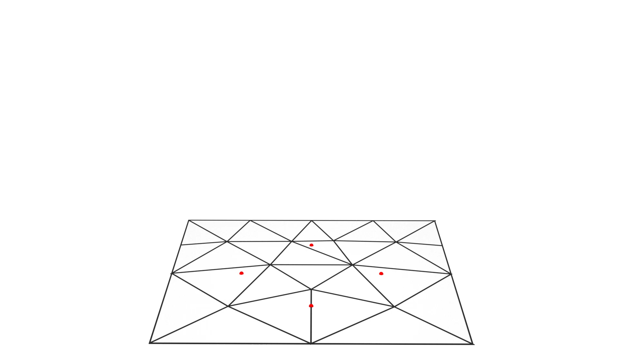
Distance Propagation
Compute distances in embedding space
Each site propagates distance field from adjacent triangles outward
Continue until no undefeated and unpropagated distance events remain
Each triangle stores all contributing distance fields during propagation
Notes:
In the distance propagation step, we compute distances in embedding space. Each site begins propagating its distance field from its adjacent triangles outward, spreading across the mesh surface.
During this propagation process, each triangle maintains a record of all the distance fields that contribute to it - essentially keeping track of which sites have influence within that triangle.
We continue this propagation until no undefeated and unpropagated distance events remain across the entire mesh.

Slide 11
Incremental Cutting
Per-triangle Voronoi extraction:
Independent processing: Handle each triangle separately
  3D lifting: Each site's distance field → half-plane in 3D
  Z-axis represents distance value
Lower envelope computation: Incrementally cut with half-planes
  Preserve only the lower envelope surface
2D projection: Project envelope intersections back to triangle
Result: Voronoi boundaries within triangle
Notes:
For the final step, we perform per-triangle Voronoi extraction. We handle each triangle independently using 3D lifting - each site's distance field becomes a half-plane in 3D where the Z-axis represents distance value.
We then compute the lower envelope by incrementally cutting with half-planes, preserving only the lower envelope surface. Finally, we project envelope intersections back to the triangle to get Voronoi boundaries within each triangle.

Slide 12
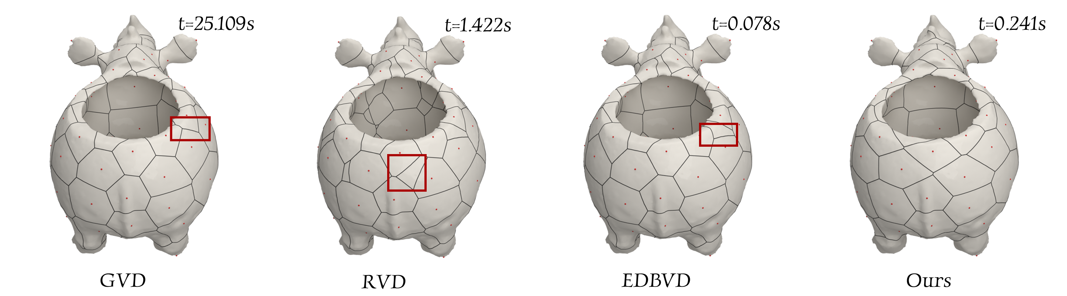
Comparison
smooth but slow
fast but fragmented regions
better than RVD
but still has irregularities
fast, connected,
well-aligned regions
Notes:
Here's a comparison between different approaches. GVD produces smooth results but is computationally slow. RVD is fast but creates ownerless regions. EDBVD is better than RVD but still has irregularities. Our method achieves fast computation while producing connected and well-aligned cells.

Slide 13
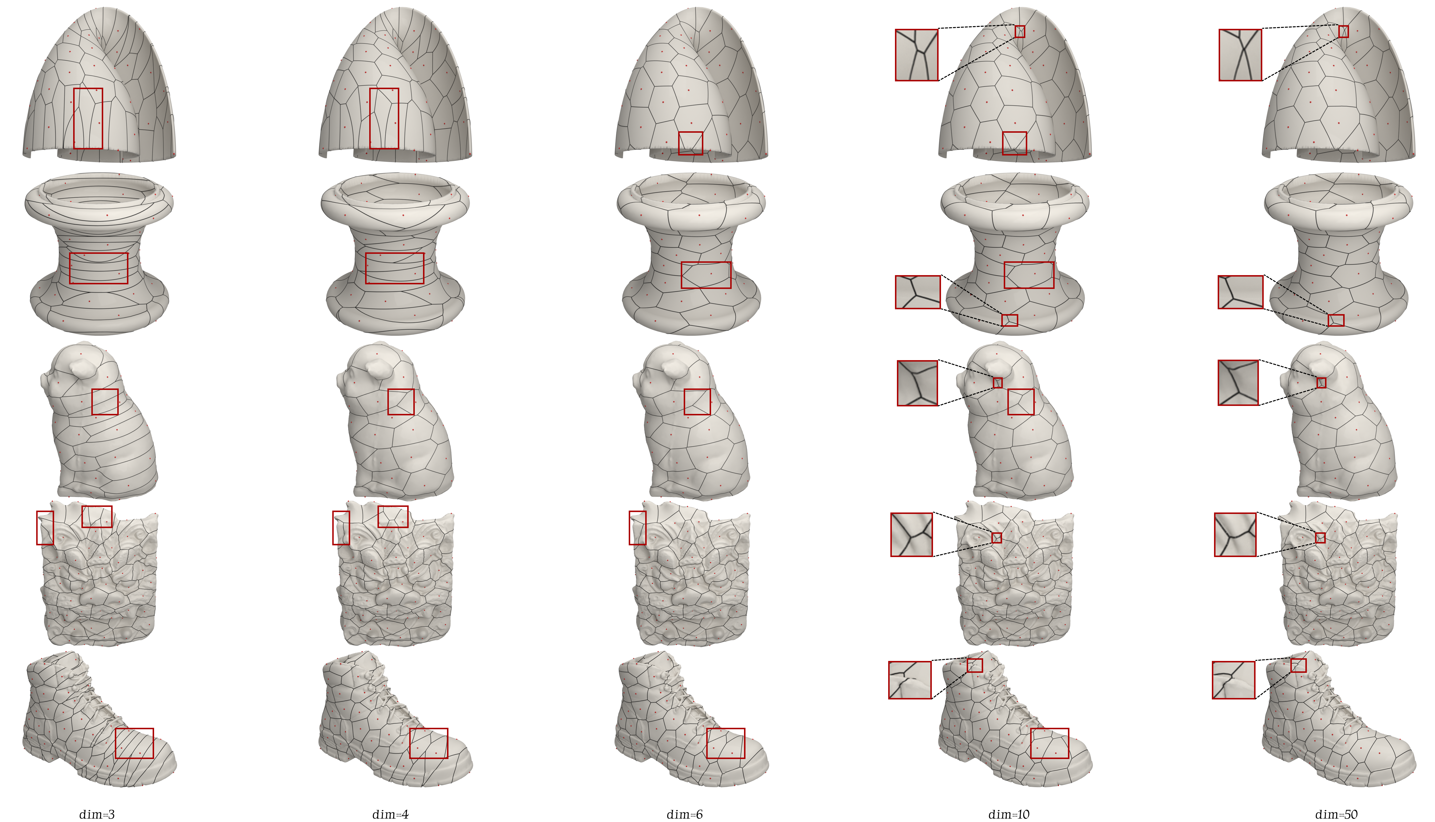
Ablation Study: Embedding Dimension
d = 10 is a good trade-off
Notes:
We conducted an ablation study on embedding dimension. If the dimension is too small, the embedding cannot capture enough geometric details. If too large, computation becomes expensive without clear improvement. Through experiments, we found that d = 10 offers the best trade-off between geometric fidelity and computational cost.

Slide 14
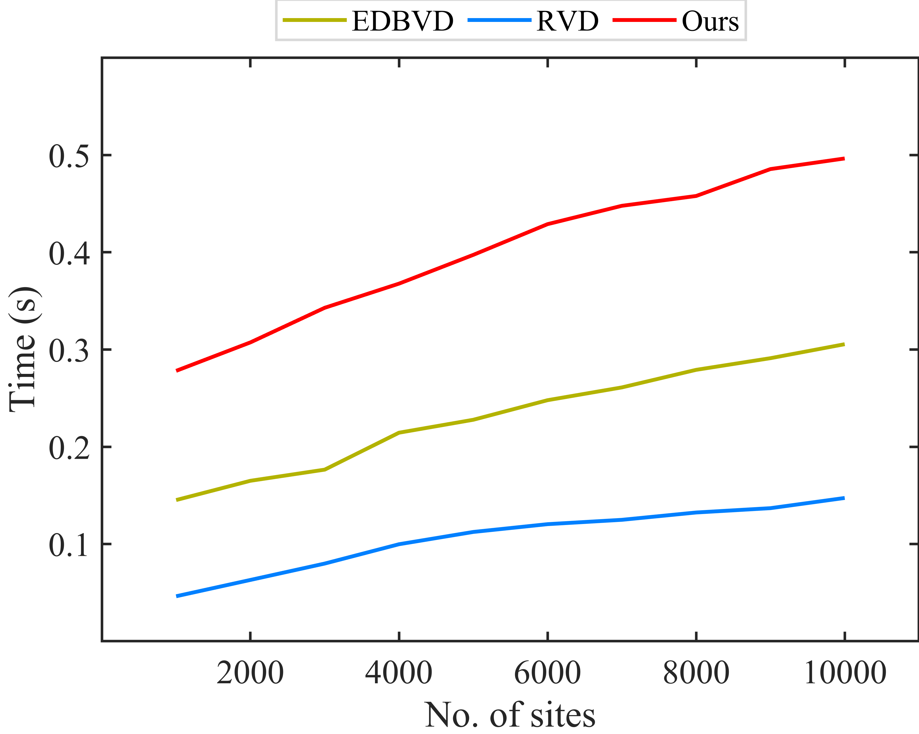
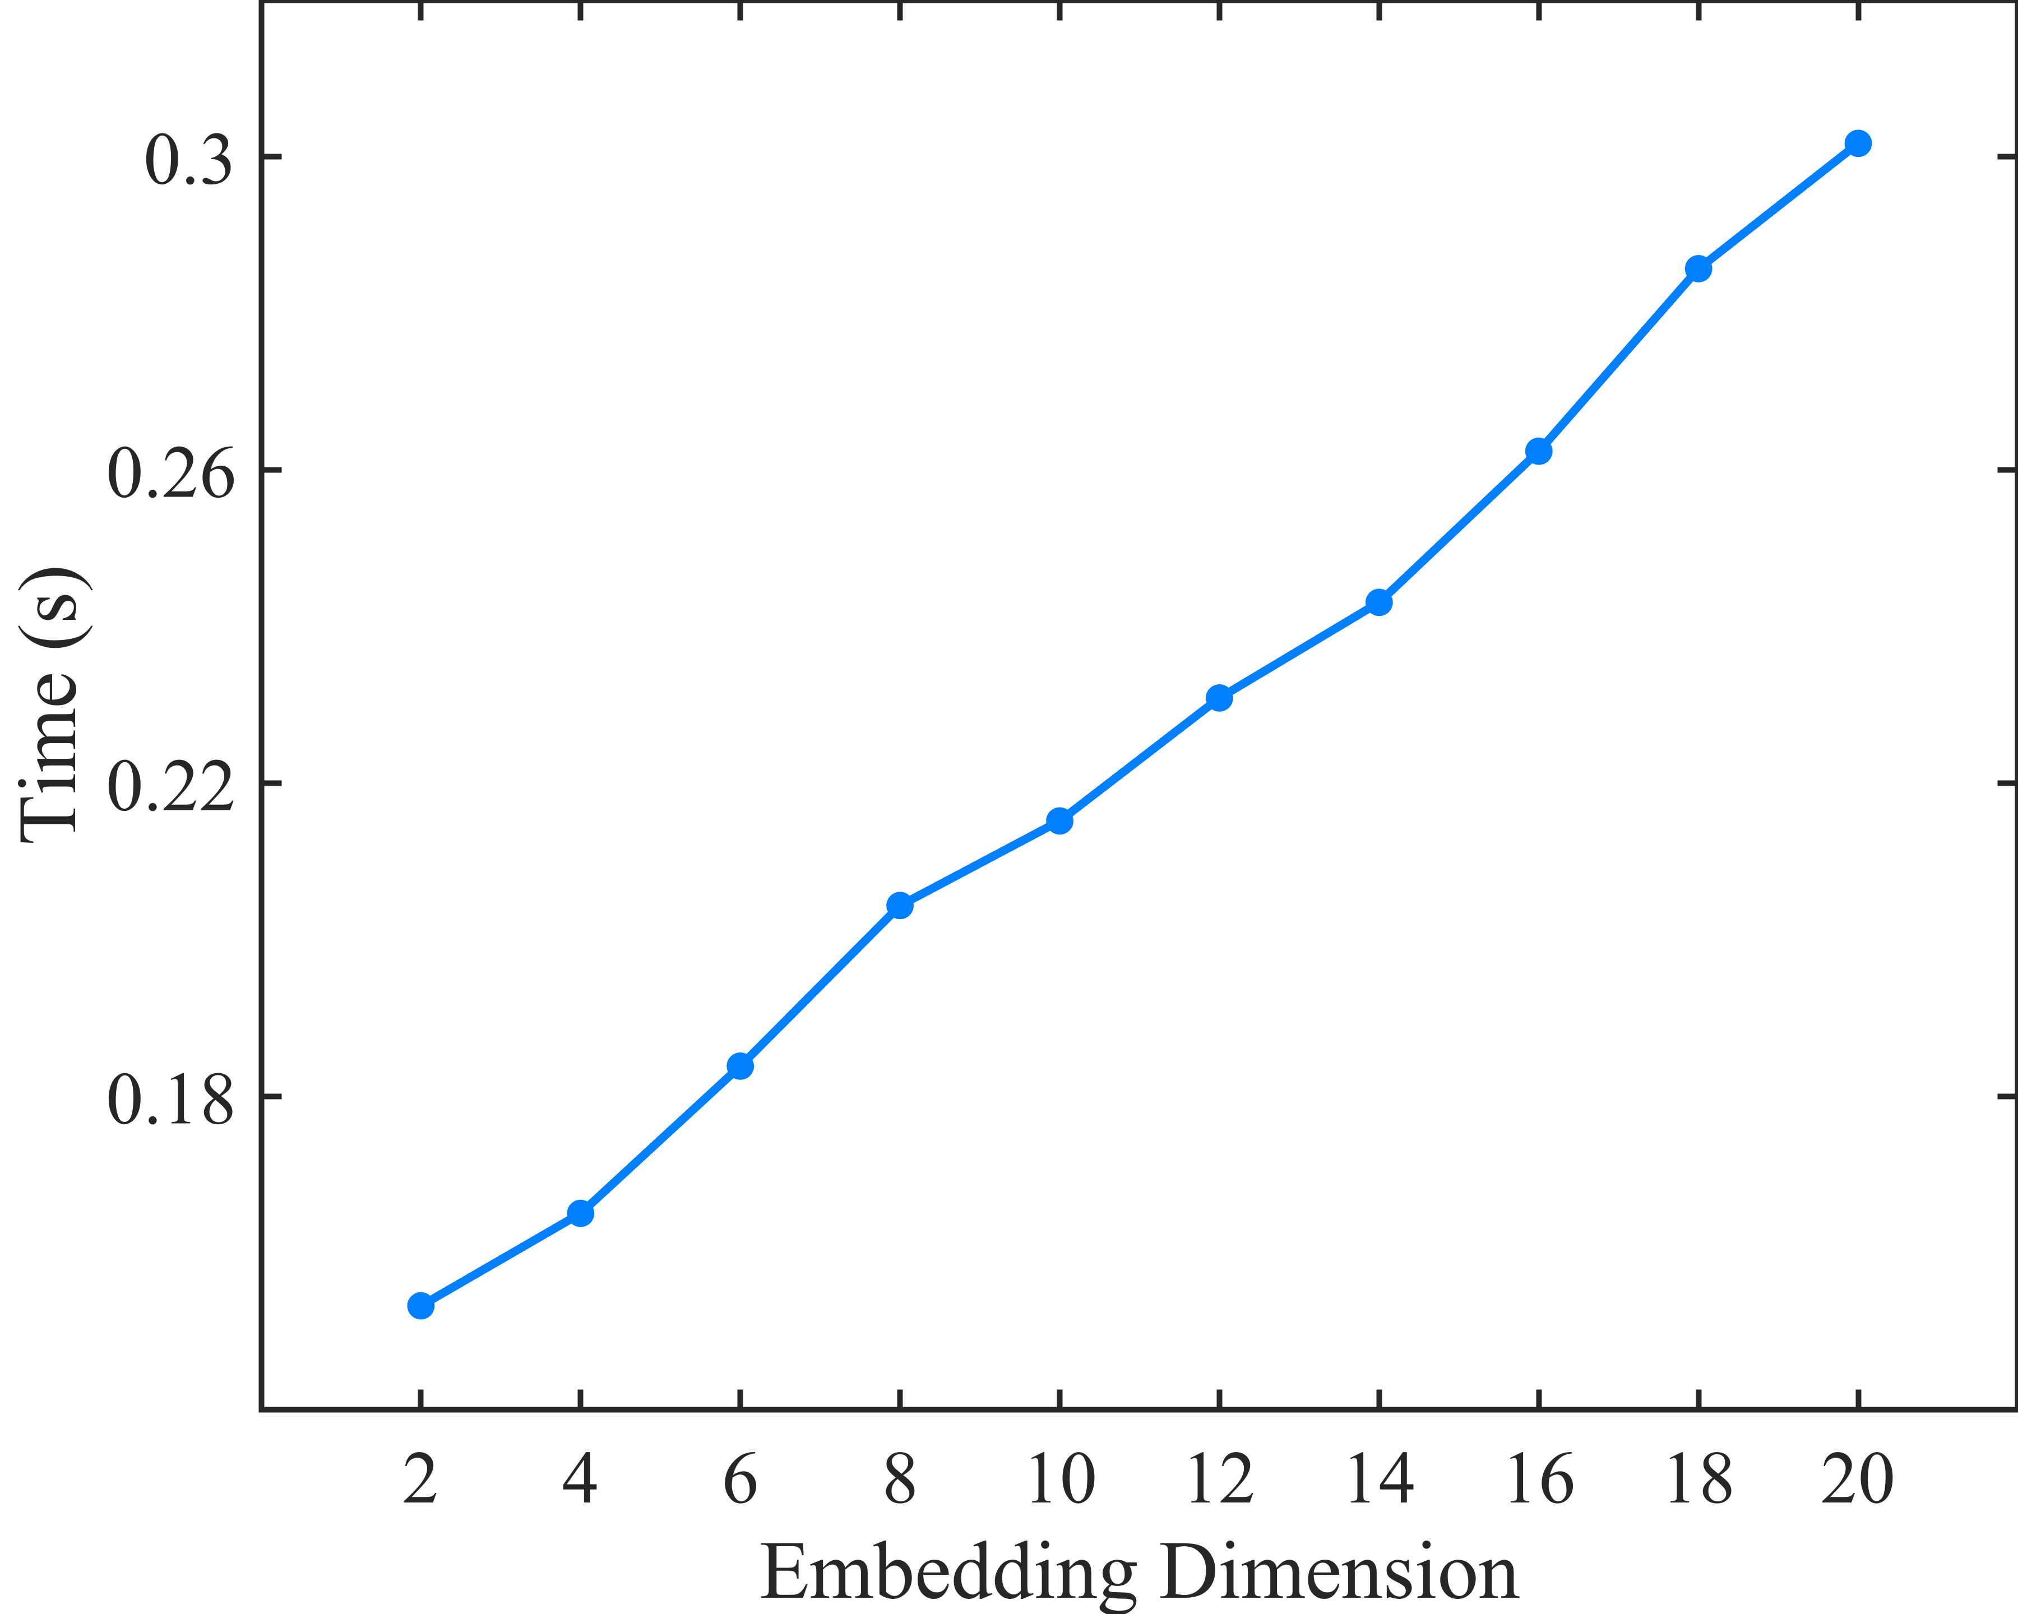
Runtime
Runtime vs. Embedding Dimension
Runtime vs. Number of Stations
Linear scalability with site count
Fast embedding (<1s for d ≤ 20)
RVD is fastest but inaccurate
EDBVD is efficient but less stable
Accuracy with moderate time cost
Notes:
Our runtime evaluation shows linear scalability with site count and fast embedding computation - less than 1 second for dimensions up to 20. While RVD is fastest but inaccurate, and EDBVD is efficient but less stable, our method achieves high accuracy with moderate time cost.

Slide 15
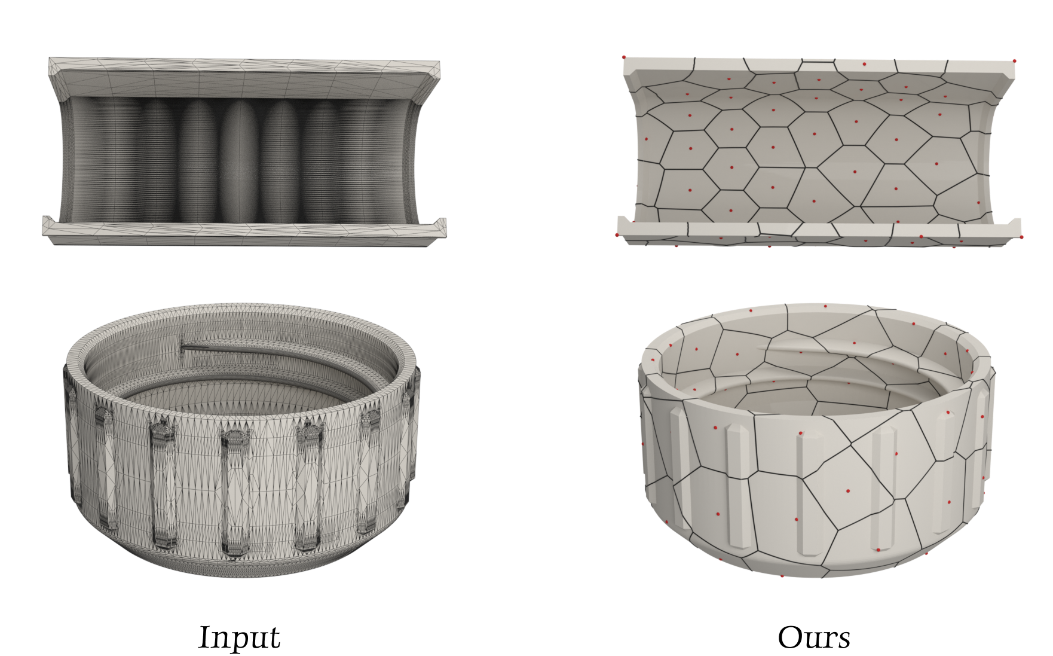
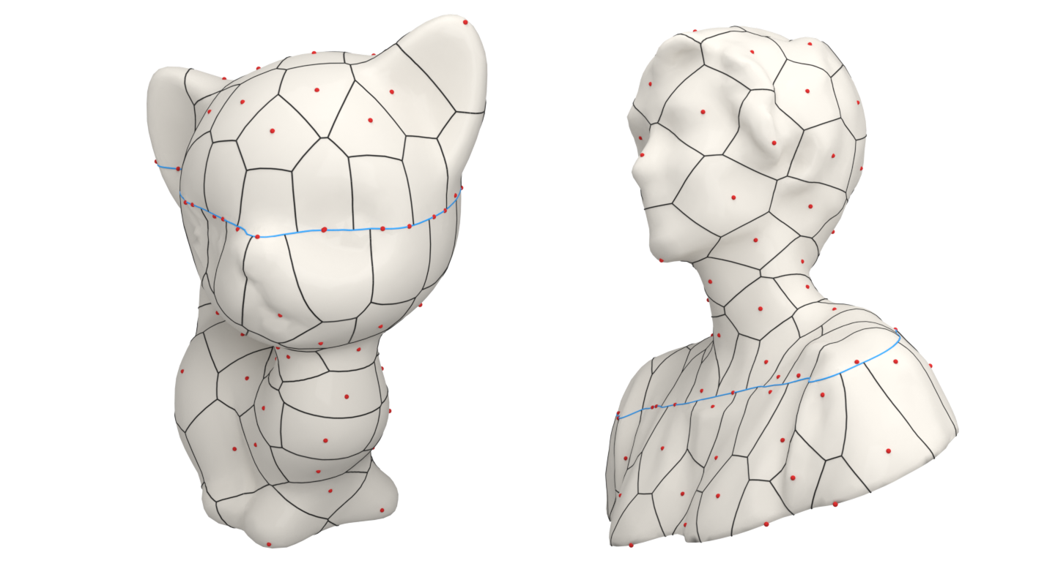
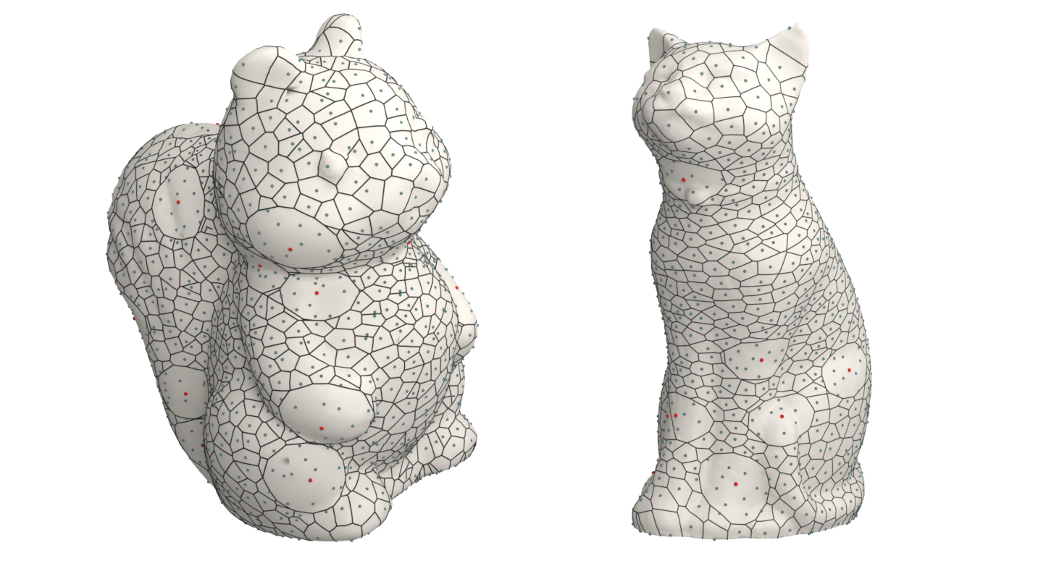
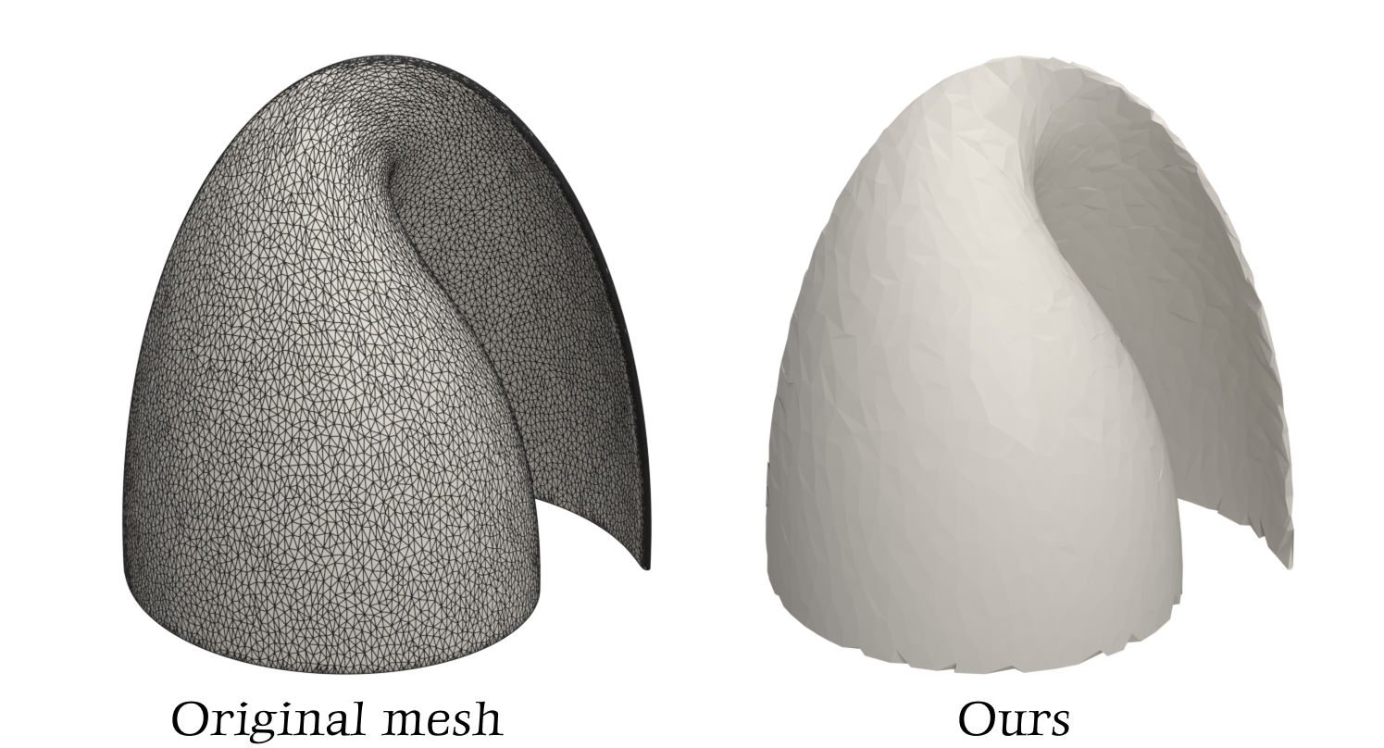
Applications& Extensions
Robust to poor triangulation
Breakline constraints
Power diagrams (weighted sites)
Remeshing (better feature alignment)
Notes:
Our method supports various applications and extensions, demonstrating its versatility in real-world scenarios.
First, it's robust to poor triangulation quality. Even when you have meshes with irregular or elongated triangles, our method still works well and produces reasonable results.
We also support breakline constraints, which is really useful in practice. You can define important feature lines that the Voronoi boundaries should respect, giving you more control over the final partitioning.
Another extension is power diagrams with weighted sites. This means some sites can have more influence than others, which gives you much greater flexibility in modeling different scenarios.
Finally, our method can be applied to remeshing tasks, producing good feature alignment and making it quite practical for geometry processing applications.

Slide 16
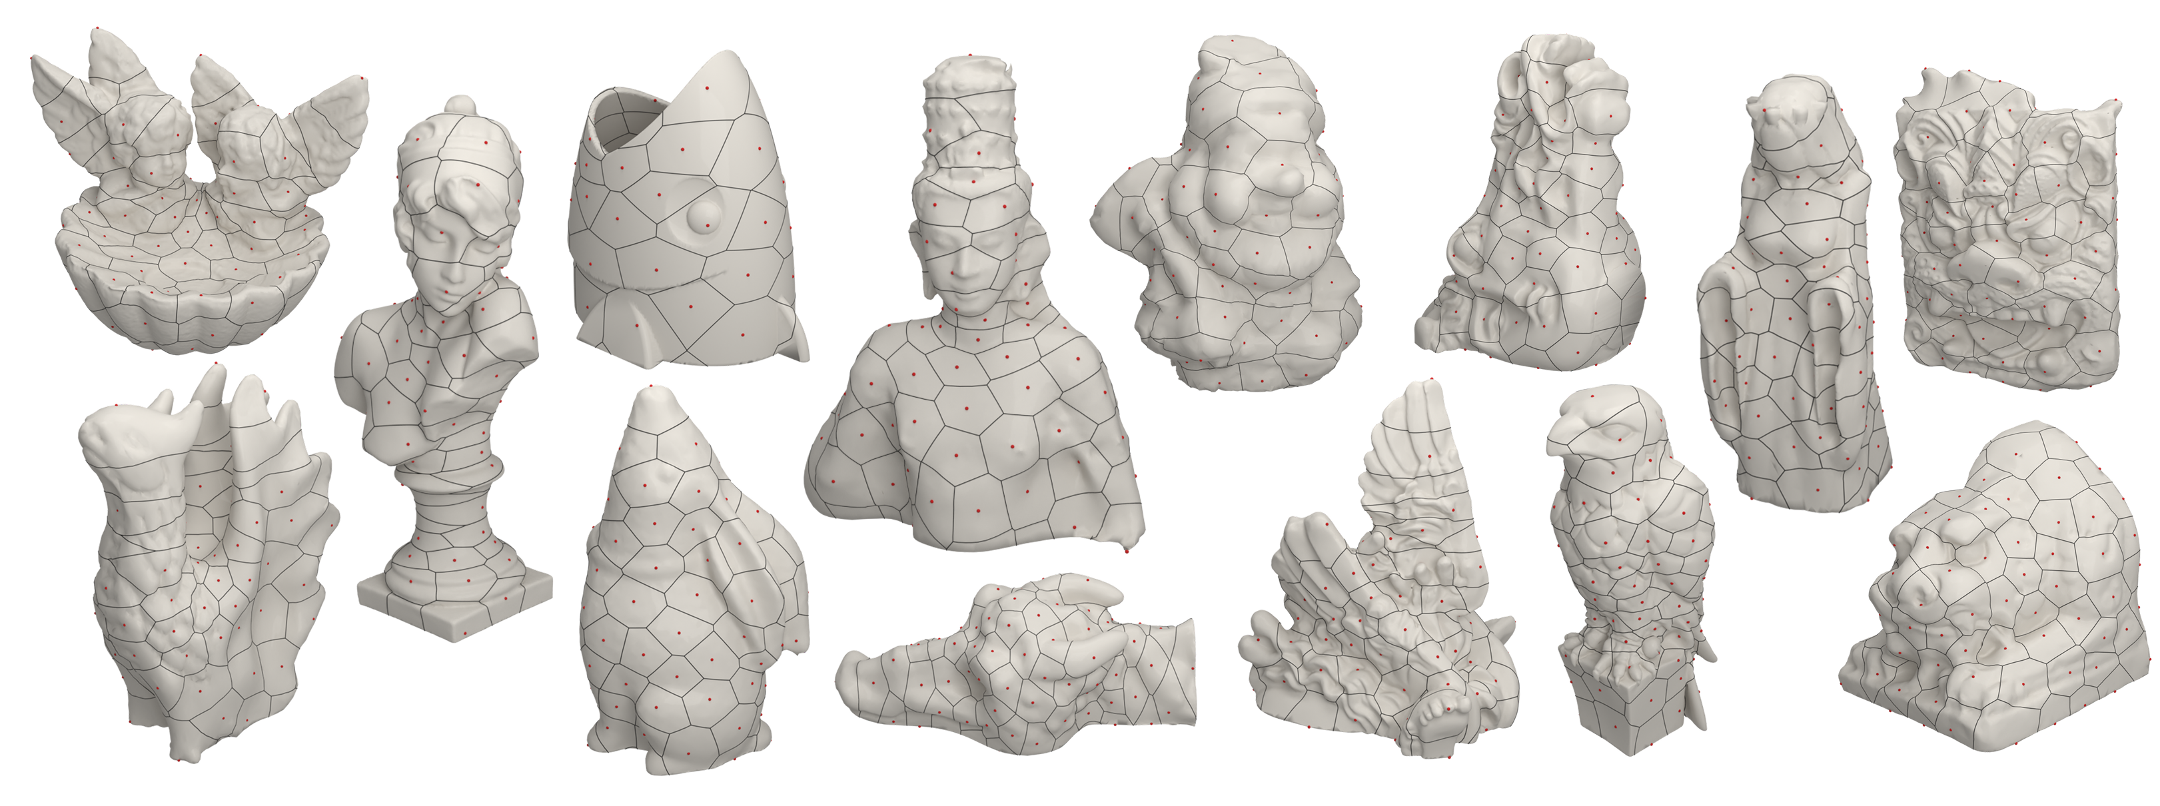
Conclusion
High-quality, geometry-aware partitions
Good balance: accuracy vs efficiency
Notes:
To conclude, we presented a method for constructing Biharmonic Distance Driven Voronoi Diagrams on curved surfaces. Our approach produces high-quality, geometry-aware partitions that are smooth, connected, and well-aligned with the underlying surface.
It achieves a good balance between accuracy and efficiency - more reliable than Euclidean-based methods and much faster than geodesic approaches. We believe this makes Biharmonic Distance a very promising metric for surface partitioning and geometry processing tasks.

Slide 17
thanks
Notes:
Thank you very much for your attention.
We organize the propagation using a priority queue approach. The choice of priority strategy doesn't affect the final results because we employ the distance field comparison strategy - we store all contributing distance fields within each triangle.
However, different priority strategies do impact algorithmic efficiency. In our implementation, we use the minimum distance from a site to the triangle's vertices as the priority criterion, but this is interchangeable.
You could use other metrics like average distance, and while the propagation order would change, the final Voronoi boundaries remain the same.

